Slide 1
Workflow for the Integration of Heritage Digital Resources
ITN- DCH Digital Heritage Conference
Olimje, Slovenia
23/05/2017

Slide 2


Data Engineering
Cultural Heritage
Open Data
Ontology & Semantics
Data Provenance
Data Mapping
Philosophy
Data structure
Ontology & Semantics
Data Provenance

Slide 3
Schedule
14:00 - Introduction to Data integration and Semantics
14:20 – 15:30: Data Engineering with OpenRefine I
15:30 -16:00: Coffee break
16:00 – 16:20: Data Engineering with OpenRefine II
16:20 – 18:20 Semantic Mapping with CIDOC-CRM
18:20 – 18:30 Wrap-up

Slide 4

Acknowledgement
This project has received funding from the European Union’s Seventh Framework Programme for research, technological development and demonstration under grant agreement no 608013

Slide 5
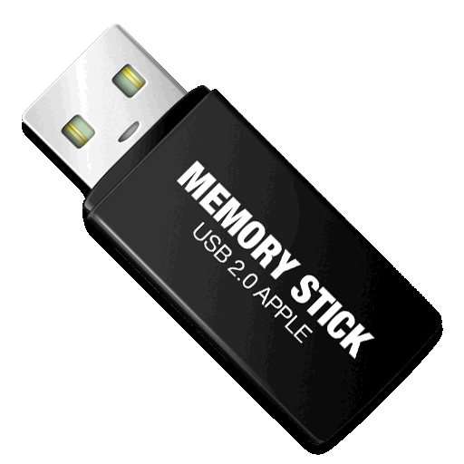
Before we start…
Install Vagrant Virtual Machine
Register to 3M for the second part of the workshop
http://139.91.183.3/3M
https://github.com/ncarboni/ITNDCH_workshop

Slide 6
Introduction to Data Integration and Semantics
George Bruseker & Nicola Carboni
ITN DCH Digital Heritage Conference
Olimje, Slovenia
23/05/2017

Slide 7
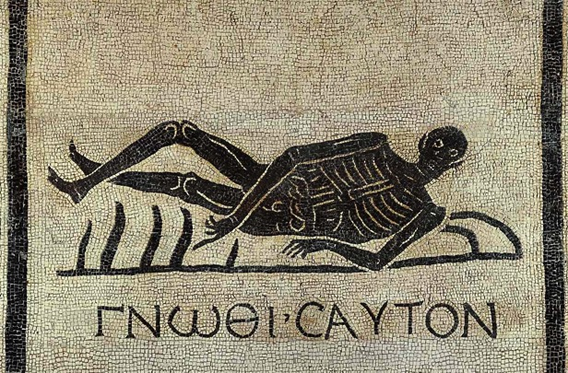
Information Diversity: What’s the problem?
Actors working in the field of Cultural Heritage generate information which can be used to build / come to knowledge about the human past.
This info comes from diverse sources, as a result of diverse methods, using diverse formats and focuses on diverse things. We must take into account (at least):
Institutions { Museums, Libraries, Archives }
Professions { historians, museologists, conservators, archivists }
Tools {databases, software, schemata}
Objects {documents, objects, buildings, actors, places}
A positive problem:
We have so much information from so many sources, how can we bring it together towards its central aim: (self) knowledge

Slide 8



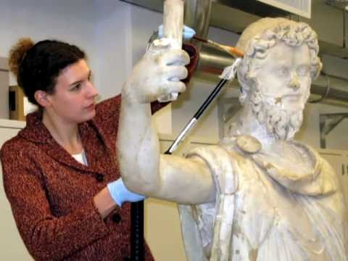
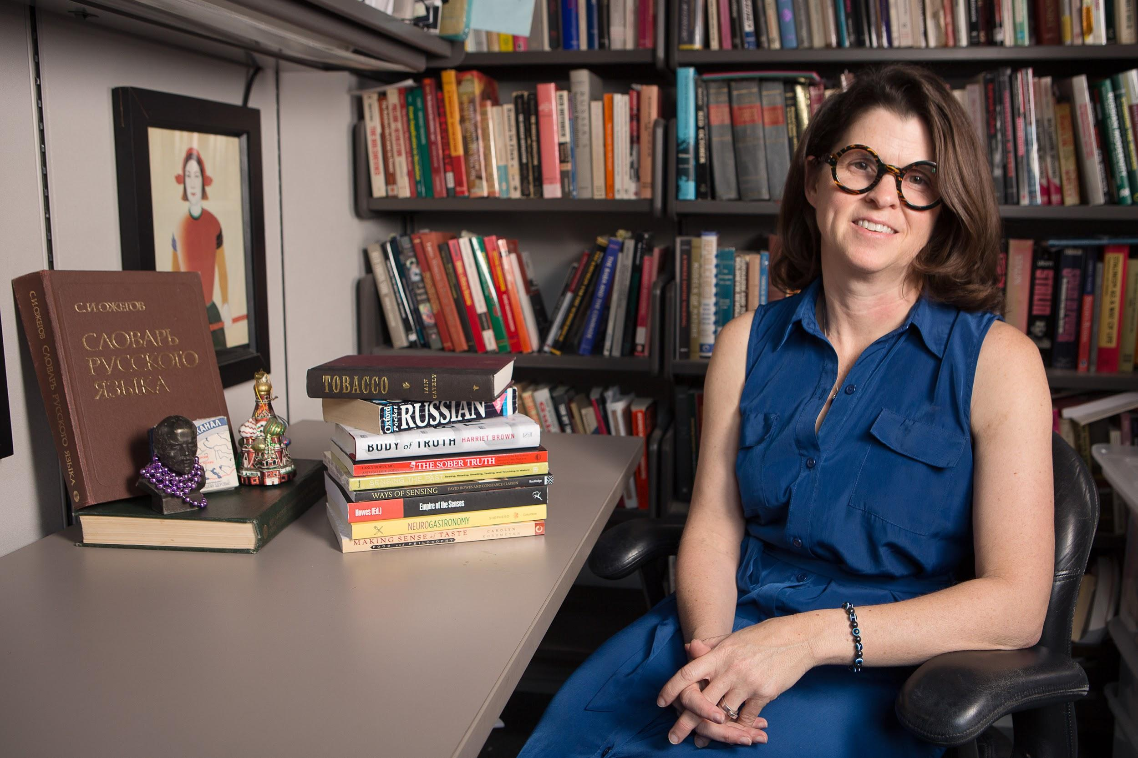
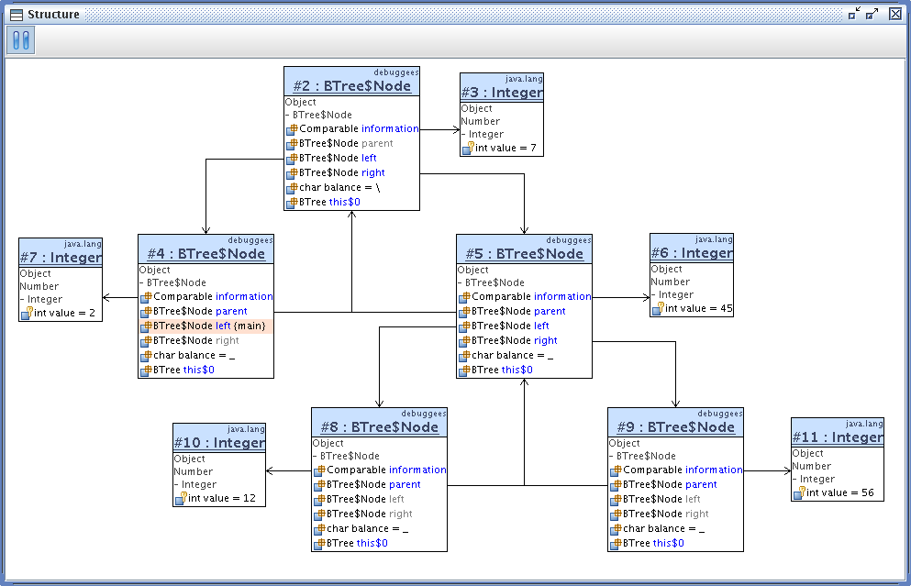

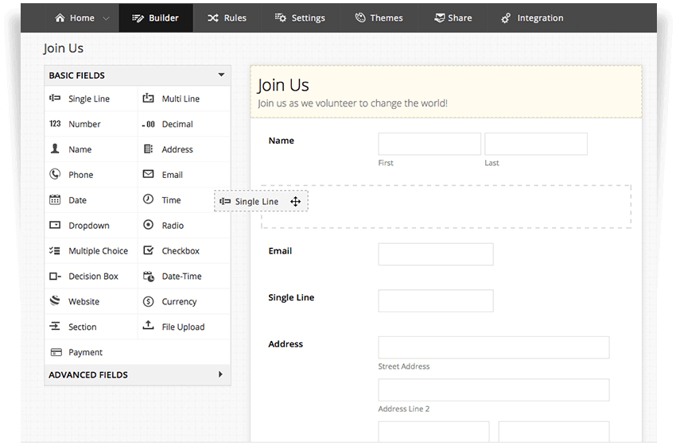
Specialists (stuck?) in their worlds
Increased knowledge?
observe
publish
ground
input
Reach / understand
/ critique
store

Slide 9
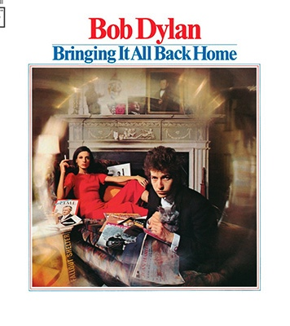
The Crimea Conference Example
Researcher wants to find all evidence and relevant material to Crimea conference
Researcher wants to use textual sources, photographic archive and relevant geographic data to understand context and elements of this historic moment
One standard won’t do, and two or more standards leaves the data unrelated

Slide 10
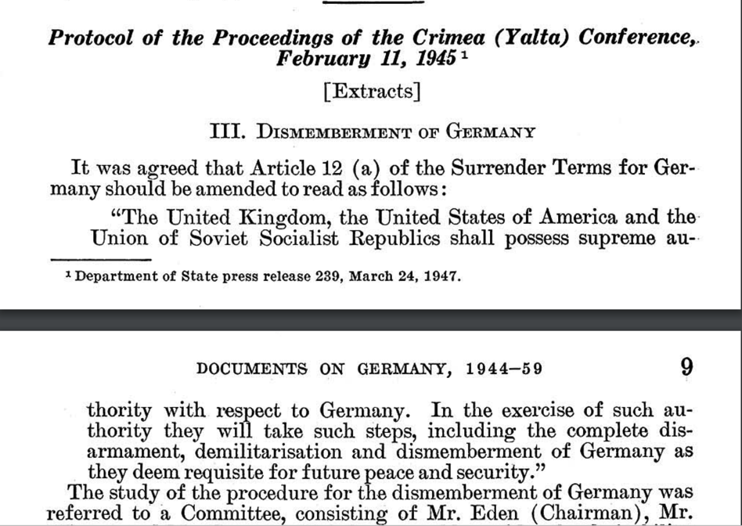
Crimea Conference Historical Archives….
Standard:
Dublin Core OR
EAD?
Field | Value
Type | Text
Title | Protocol of Proceedings of Crimea Conference
Subtitle | Declaration of Liberated Europe
Date | February 11, 1945
Creator | The Premier of the Union of Soviet Socialist Republics The Prime Minister of the United Kingdom The President of the United States of America
Publisher | State Department
Subject | Postwar division of Europe and Japan
metadata for
Metadata
About…
Documents

Slide 11
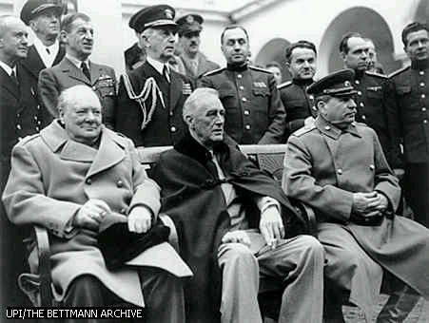
Crimea Conference Images, non-textual objects…
about
Standard:
Dublin Core OR
IPTC?
Field | Value
Type | Image
Title | Allied Leaders at Yalta
Date | 1945
Publisher | United Press International (UPI)
Source | The Bettman Archive
Copyright | Corbis
References | Churchill, Roosevelt, Stalin
Metadata
Photographs

Slide 12
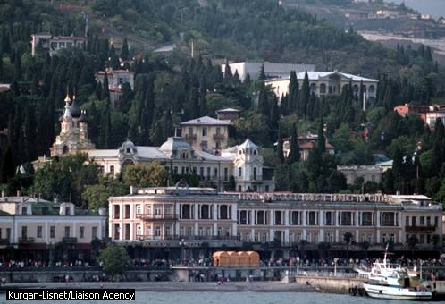
Crimea Conference Places and Objects
Standard:
TGN OR
Geonames?
Field | Value
TGN ID | 7012124
Names | Yalta (C,V), Jalta (C,V)
Types | inhabited place(C), city (C)
Position | Lat: 44 30 N,Long: 034 10 E
Hierarchy | Europe (continent) <– Ukrayina (nation) <– Krym (autonomous republic)
Note | …Site of conference between Allied powers in WW II in 1945; ….
Source | TGN, Thesaurus of Geographic Names
about
About…
Places

Slide 13
Source of Fuzziness: language
Tree
Albero
Arbre
Baum
Baum
Trae
Timber
Legno
Bois
Holz
Wood
Skov
Bosco
Wald
Forest
Foresta
Forêt
Notes:
It is important to highlight that the diversity in information do not derives only by technical and methodological choices, but it is intrinsic in our categorisation of the world. There are subtle and gradual difference in the meaning of the terms that make it quite fuzzy for a computer to understand, and it is our role to make it explicit.

Slide 14
Problem: homonym
Bank
Notes:
There is not real one-to-one labeling relationship between single words and single concepts. The lexicon is way more complex and it clearly influence how we define things in our data and, therefore, what we need to retrieve them. The case of bank is paramount and very easy to catch. As label can be used to define two diverse thing.

Slide 15
Problem: polisemy
Warm
Notes:
Things can get even more complicated than that, and that is why we absolutely need to take into account semantics for a proper data integration job.

Slide 16
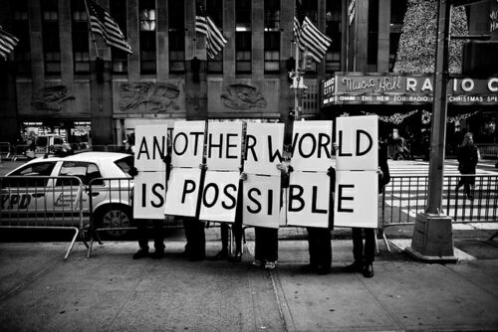
We need: a different approach

Slide 17
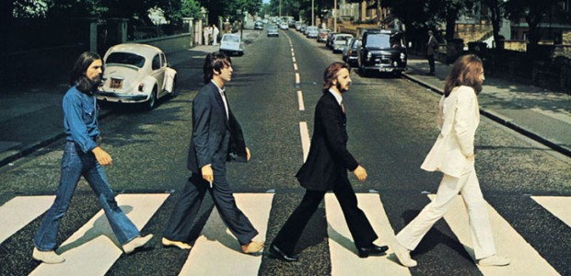
How to create successful integrations?
Schema Standard
Semantics-Ontology
Useful in a limited context where agreement can be had amongst all actors or enforced
Useful for more limited contexts, where domain is relatively standardized and closed.
Useful when data to be covered is heterogenous
Useful when teams are dispersed
Useful when tools are necessarily diverse
Can/should be combined with standards

Slide 18

What is an ontology? (What is it not?)
A window / frame which allows expression of the world according to the kinds of statements used by a domain(s)
Not a description of the world as such (not Ontology)
Plural not singular
Heidegger’s ‘domain ontology’

Slide 19
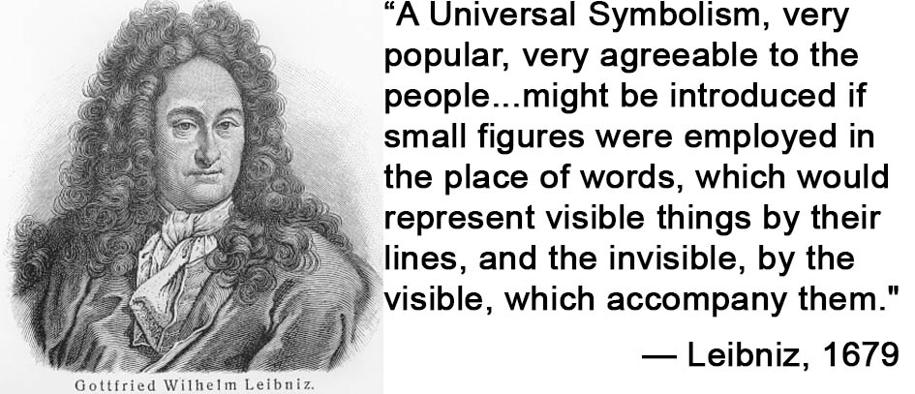
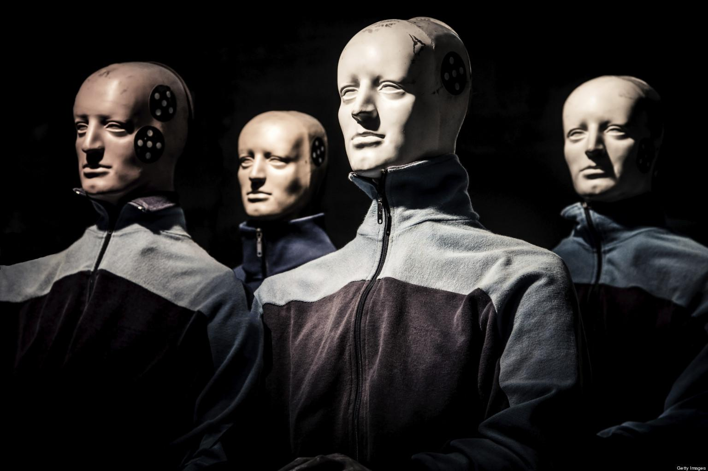
What is an ontology? (What is it not?)
Mix of computer science and philosophy
Bridge between computer science world and data producers/researchers
Formalization of knowledge domain
Bound to a reality
Creates a lingua franca
Machine Processable, Human Readable

Slide 20
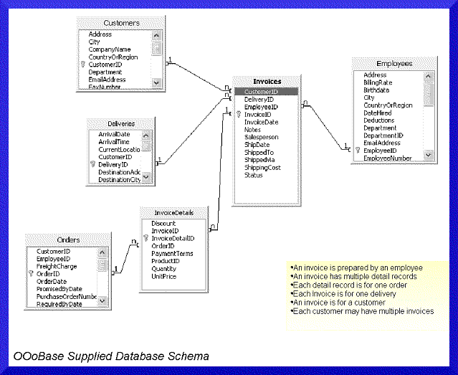
What kind of data can a formal ontology produce?
Triples (Subject - Verb - Object)
Traditional RDBMS
E13 Attribute Assignment
“Curatorial Project”
P140 Assigned Attribute to
E22 Man Made Object
“Pot”
VS.
E16 Measurement
“Curator Measurement”
E22 Man Made Object
“Pot”
P39 measured
In a graph, supporting subsumption relation

Slide 21
What kind of data can a formal ontology produce?
E16 Measurement
P39 measured
E22
“Pot”
Object Table
ID | 101
Name | Pot
Weight (kg) | 55
P40 observed dimension
E54 Dimension
P90 has number
E60 Number
“55”
P91 has unit
E58 Measurement Unit “kg”
Rendering the implicit, explicit

Slide 22
Integrated Data Picture
global
relationships
and core entities
CIDOC CRM
& extensions
detailed
terminology
thesauri extend
CRM classes
(e.g., SKOS)
Events
Actors
Objects
integrated
knowledge
CRM instances
(metadata repository,
LoD)
local
collection data
content &
metadata
(XML/RDBMS)
Support interoperability of mutually relevant data sources
enable sourced and verifiable facts from datasets
foster referenceability and reusability of data
foster structured argumentation on top of facts

Slide 23
Query: FIND things (?) that refer to Ramesses II
E39 Actor
Ramesses II
P67 refers to
P62 depicts
E22 Man-Made Object
Head of Ramesses
P62 depicts
P62 depicts
P62 depicts
P46 is composed of
E22 Man-Made Object
D9 Data Object
D9 Data Object
Ramesses Statue 1
Scanned Ramesses Statue 1
3D model of Ramesses Statue1
L1 digitized
L20 has created
L21i was derivation source for
L22 created derivative
D2 Digitization Process
D3 Formal Derivation
Laser scanning of Ramesses Statue 1
MeshLab processing of Ramesses Statue 1

Slide 24



Workflow
Heterogeneous, Related Datasets
Standard,
Ontology
X3ML Mapping Files
DBs
Data Extraction and analysis
Cleaning and Enrichment
Learn target schema
Create mappings
Implements generator
Transform
Data
Explore Harmonized Data
Data Engineer
a. Initial Setup
b. Occasional Review
c. Scheduled Ingests and Updates
Data Engineer
Domain Specialist

Slide 25

CONCEPT
has subject
refers to
Document
Web page
author
refers to
Notes:
It is important to re-project this effort on a global scale. We can easily see that we are changing our web model from textual hyperlink within webpages to web formats that enable individual entities described in a particular web document to be connected by normalised links to their related entities. We, therefore, switch from an HTML based model to a data based model which would produce machine-readable data that would specify relationships between entities and not simply connect documents together. It is the core of the concept of Semantic Web.

Slide 26
{Subject}
+
{Predicate}
+
{Object}
Nicola
isA
Person
Engine
isPartOf
Car
Things
hasProperty
Value
IRI
IRI
IRI
Notes:
We saw before what kind of data structure we could obtain. The W3C release in 2004 the first version of the specification of RDF, Resource Description Framework, which is a data model that can be used for encoding normalise statements about resources in the web.

Slide 27
Notes:
It become part of a bigger architecture of specification, which define how we can use, encode and retrieve this information over the web.

Slide 28
<http://example.com/ResourceX>
http://purl.org/dc/elements/1.1/creator
<http://example.org/07865>
rdf:type
foaf:name
<http://xmlns.com/foaf/0.1/Person>
“Nicola”^^xsd:string
Notes:
The encoding is XML based and, as we mentioned before, it is made out of triples which great a graph representing a set of statements about some objects.

Slide 29
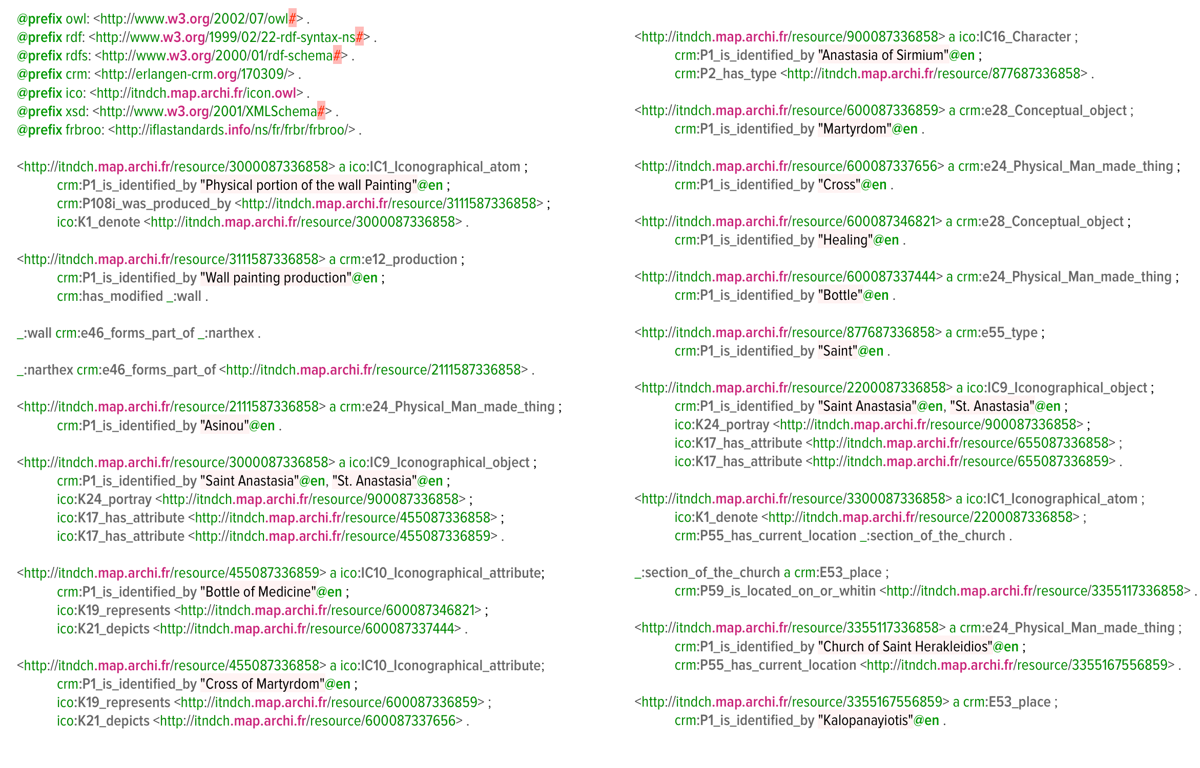
RDF Data
Notes:
A typical RDF file can be encoded into different formats. This is a Turtle, an easy to read encoding. We can see in the initial part of the document that we call the ontology in order to define the terms used in the triple below.

Slide 30
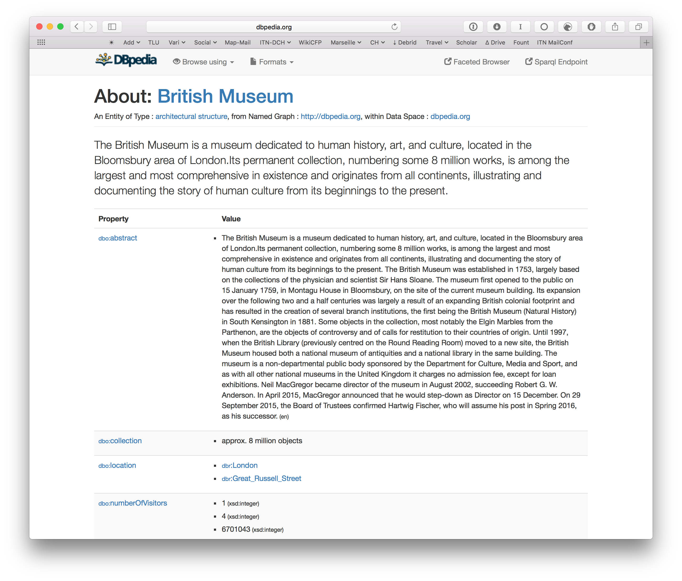
Notes:
Now, as users, that’s not what you would see. The data level is interpreted and formatted to provide human-readable information into a webpage.

Slide 31
Recap
Integrate heterogeneity
Diverse vocabularies and semantic
Knowledge graph VS Data Silos
Easier analysis
Interconnect dataset
Enriched information
Always updated
Maintenance flexibility
External authorities => less maintenance cost
One URI diverse serialisation (Content Negotiation)
Notes:
So, as a recap, why we are doing this? There are several advantages which is to integrate (keeping their semantics) diversity, interconnect datasets, and a have certain flexibility in the maintenance of the data.

Slide 32
Next Steps
Data integration with OpenRefine
What it is: quick introduction
Data discovery
Data clusterisation
GREL
Data enrichment
Semantic mapping with CIDOC-CRM
High Level Intro to CRM
Semantic Mapping Strategies
High Level Intro how to use X3ML Mapping Toolkit
Notes:
After this initial introduction we are now going to start working. We are going to start with OpenRefine, specifically with point 1,2,3,4,5 and then…

